Slide 1
PROJECT DEMONSTRATION
Team I’d: PNT2022TMID49261
Project title: Real-Time Communication System Powered by AI for Specially Abled.
Team Members : AHELESWARAN.E
PRIYADHARSAN .B
RAAGHUL. R
RAGULPANDIYAN. K

Slide 2
AGENTA
PROJECT OBJECTIVES
PROJECT FLOW
PRE-REQUISITES
DATA COLLECTION
IMAGE PREPROCESSING
MODEL BUILDING
VIDEO ANALYSIS
TRAIN CNN IDEAL ON IBM

Slide 3
PROJECT OBJECTIVES
The project aims to develop a system that converts the sign language into a human hearing voice in the desired language to convey a message to normal people, as well as convert speech into understandable sign language for the deaf and dumb.
We are making use of a convolution neural network to create a model that is trained on different hand gestures. An app is built which uses this model.
This app enables deaf and dumb people to convey their information using signs which get converted to human-understandable language and speech is given as output.

Slide 4
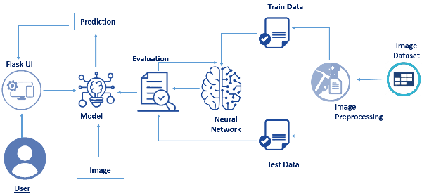

Slide 5
PROJECT FLOW
The user interacts with a web camera to read the information from the images are video outputs.
Once the model gets the input image From the video frame , if a fire is detected,it is displayed on the console, an alerting sound is generated,and the alert message is send to the authorities.

Slide 6
PRE REQUISITES
To complete this project, you must require the following software’s, concepts, and packages.
Python Packages :
Tensorflow : This package is used as backend support to Keras.
Keras : This package is used for building Neural Network layers.
OpenCV : This package is used for image processing.
Flask : To build a web application

Slide 7
If you are using anaconda navigator, follow the below steps to download the required packages:
Open anaconda prompt as administrator.
Type "pip install tensorflow==1.14.0” and click enter.
Type "pip install keras=2.2.4” and click enter.
Type "pip install opencv-python” and click enter.
4. Type “pip install imutils” and click enter.
5. Type "pip install flask” and click enter.

Slide 8
DATA COLLECTION
In this, we will be collecting data for building our project. We will be creating two folders one for training and the other for testing.
Images present in the training folder will be used for building the model and the testing images will be used for validating our model.

Slide 9
MODEL BUILDING
In this milestone, we start building our model by:
1.Initializing the model.
2. Adding Convolution layers.
3. Adding Pooling layers.
4. Flatten layer.
5. Full connection layers.
with layers we added to complete the neural network structure

Slide 10
VIDEO ANALYSIS
Now we test the model by passing an image to get predictions. While test the model we should make sure that the test image should meet the target size of the model, dimensions need to meet, and should undergo rescaling before giving it to the model.

Slide 11
TRAIN CNN IDEAL ON IBM
You can also train your Image classification Models on IBM Cloud using IBM Watson Studio Service.
This milestone lets youTrain your model on IBMStore your Model on IBMDownload the Stored model to the Local system

Slide 12
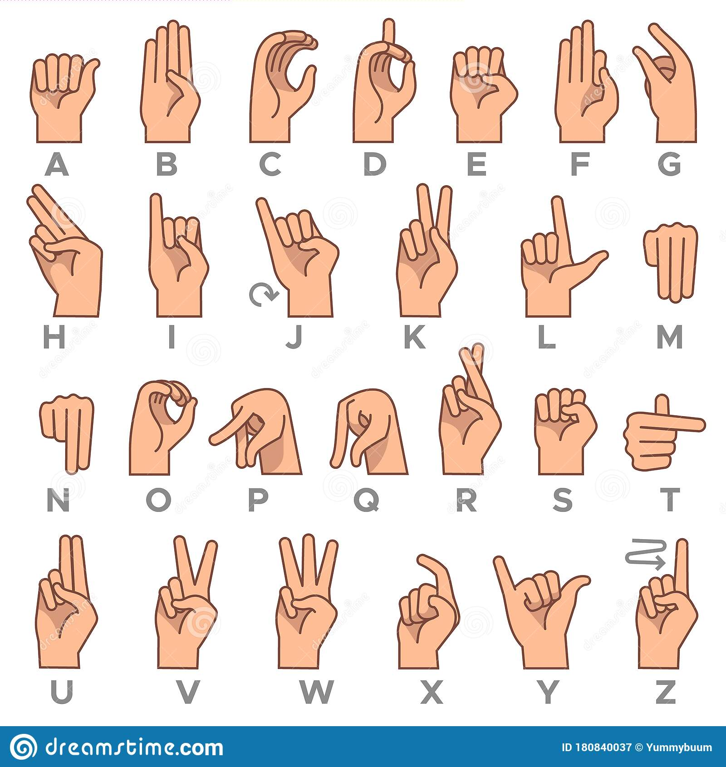

Slide 13
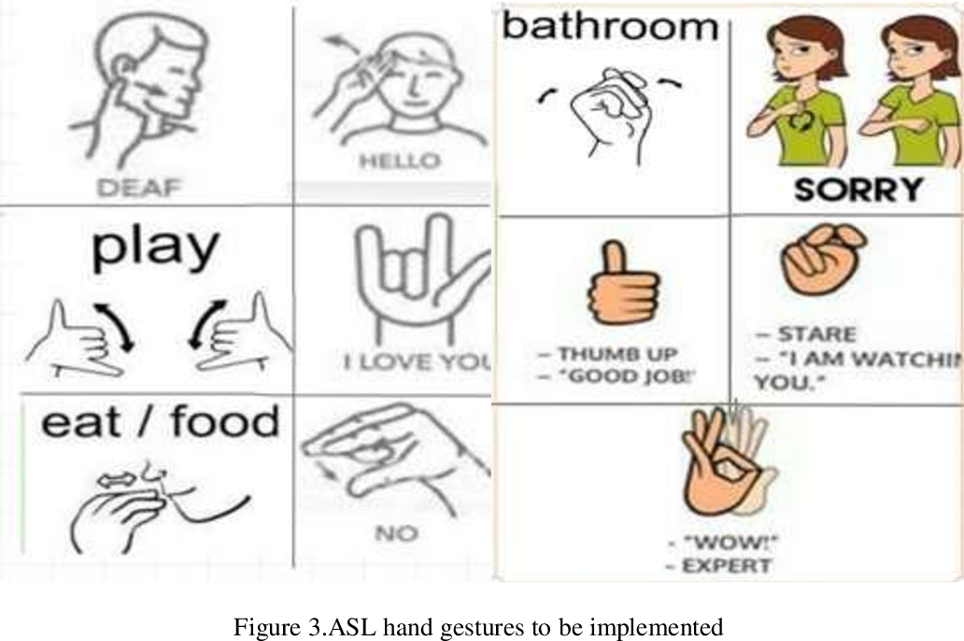

Slide 14
THANKYOU

